Slide 1

Market Failures
ASYMMETRIC INFORMATION
HL Only
2.10
Copyright Bananaomics

Slide 2

A Problem With The Free Market
Information . . .
The free market assumes that consumers and producers are rational, profit/utility-maximizing and that both parties have perfect information.
However, all parties typically don't have perfect information. . .
Copyright Bananaomics

Slide 3

Terms to Know
Asymmetric Information
Where one party in an economic transaction has to more or better information than another. Information is not symmetrical (the same for each side)
Copyright Bananaomics

Slide 4

Two Types of Asymmetric Information
Adverse Selection
A situation where one participant has more information than another before the transaction occurs.
Moral Hazard
A situation where one participant takes on more risk because they understand they will not pay the consequences of that risk.
Unlike adverse Selection, the information only changes after the transaction has occured.
Copyright Bananaomics

Slide 5





Adverse Selection
A situation where one participant has more information than another before the transaction occurs.
Example: Used Car Market
Used Car Dealers are aware of which used cars are in good condition (A Peach/Plum) and which are in bad condition (A Lemon), but the buyer does not.
Copyright Bananaomics

Slide 6

ASYMMETRIC INFORMATION - MARGINAL REVOLUTION UNIVERSITY
Copyright Bananaomics

Slide 7
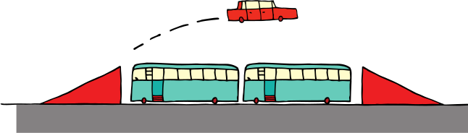
Moral Hazard
A situation where one participant takes on more risk because they understand they will not pay the consequences of that risk.
Remember: Adverse Selection takes place before the transaction while Moral Hazard takes place after.
Example: Car Insurance
Drivers with insurance may feel more at ease when they have insurance because if they are involved in an accident, they only pay a fraction of the costs. This may encourage drivers to engage in more risky driving
Copyright Bananaomics

Slide 8

Practice
Determine whether the following scenarios are Moral Hazard or Adverse Selection:
  A doctor recommending a treatment.
  A business student applying to a computer science internship knowing they will not be good at it.
  Someone taking out a loan with no limit.
Copyright Bananaomics

Slide 9
Practice
Determine whether the following scenarios are Moral Hazard or Adverse Selection:
  A doctor recommends a treatment.
    Adverse Selection - the doctor has more information prior to treatment
  A business student applying to a computer science internship knowing they will not be good at it.
    Adverse Selection - the student has more information prior to the internship
  Someone taking out a loan with no limit.
    Moral Hazard - No-limit loans promote rash spending. Their are programs available for people in severe debt such as Bankruptcy and debt forgiveness.
Copyright Bananaomics

Slide 10
Responses to Asymmetric Information
Copyright Bananaomics

Slide 11

How could the government intervene to correct asymmetric market failures?
Copyright Bananaomics

Slide 12

Government Responses
Legislation
The government may try to ensure all parties have adequate access to information by legislation.
Examples
  Adding nutritional information and ingredients in food or drinks
  Requiring health warnings on alcohol or cigarettes
  Creating laws that make it illegal for customers to give false information (insurance)
Copyright Bananaomics

Slide 13

Government Responses
Regulation
The government may try enforce monitoring of industries to reduce the impact of the market failure.
Examples
  Financial regulations for financial corporations
  Stock market regulations
  Regulations to provide information
    Public Health Campaigns
    Information about city planning or disturbances
Copyright Bananaomics

Slide 14
How could people or firms respond to correct asymmetric market failures?
Copyright Bananaomics

Slide 15


Private Responses
Firms may choose to implement changes to improve information symmetries.
Signaling
When participants have more information communicate the information to the other party.
Signaling is always done by the participant with more information.
Examples: When hiring staff, employers ask people for their skills via a Resume/CV.
SIGNALLING - MARGINAL REVOLUTION UNIVERSITY
Copyright Bananaomics

Slide 16
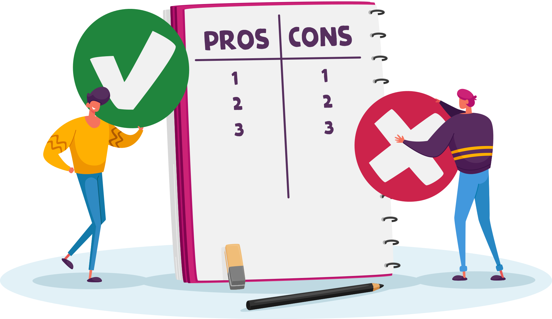
Private Responses
Pros of Signalling
  Cost-Effective
  Increases amounts of information to all participants
  Improves efficiency
Cons of Signalling
  False information
  Time Consuming
Copyright Bananaomics

Slide 17

Private Responses
Screening
When participants lack information force others to reveal information.
Screening is always done by the participant with less information.
Examples: With the same example of hiring, firms could require that all applicants have certain degrees, qualifications, or speak certain languages.
Copyright Bananaomics

Slide 18

Enjoying The Content?
Visit bananaomics.com to purchase package deals with discount prices!
BANANAOMICS

